Slide 1

IT Application and Data Security - Unit 9
- Dr. Gopal Rawat

Slide 2
Introduction to Auditing & Logging
Auditing:
Independent review and examination of a system’s records and activities
determine the adequacy of system controls
ensure compliance with established security policy and procedures
detect breaches in security services
recommend any changes that are indicated for countermeasures

Slide 3
Introduction to Auditing & Logging
A log is a record of the events occurring within an organization’s systems and networks.
Logs are composed of log entries; each entry contains information related to a specific event that has occurred within a system or network.
Usage:
troubleshooting problems
optimizing system and network performance
recording the actions of users
providing data useful for investigating malicious activity

Slide 4
Introduction to Auditing & Logging
Log management process
managing the events
reporting the shortcomings
protection its own data (CIA)
Log Analysis - system, security and network administrators.

Slide 5
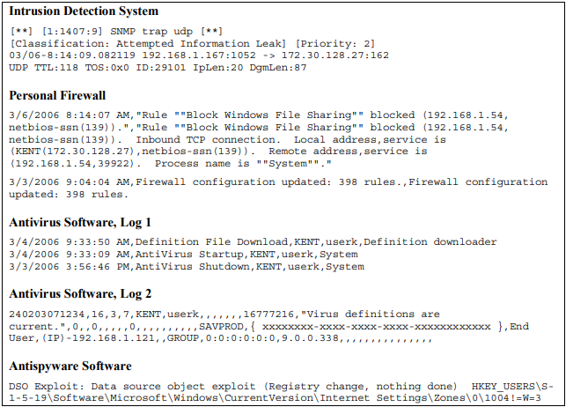
Security Software Log Entry Examples

Slide 6
Auditing & Logging: Basics
There are a number of possible security exploits, like foot-printing and possible password cracking attempts, that can occur if not detected in time.
suspicious activities can be detected by using auditing and logging
can also help deal with the threat of repudiation
series of synchronized log entries on multiple servers indicate that the user performed that transaction

Slide 7
Auditing & Logging: Threats
Top auditing and logging related threats include
● User denies performing an operation
● Attackers exploit an application without leaving a trace
● Attackers cover their tracks

Slide 8
Auditing & Logging: Threats
User Denies Performing an Operation
user denying that he or she performed an action or initiated a transaction
Countermeasures to help prevent repudiation threats include:
Audit and log activity on the Web server and database server
Log key events such as transactions and login and logout events.
Do not use shared accounts since the original source cannot be determined.

Slide 9
Auditing & Logging: Threats
Attackers Exploit an Application Without Leaving a Trace
- System and application-level auditing is required to ensure that suspicious activity does not go undetected
Countermeasures to detect suspicious activity include:
- Log critical application-level operations.
- Use platform-level auditing to audit login and logout events, access to the file system, and failed object access attempts.
- Back up log files and regularly analyze them for signs of suspicious activity

Slide 10
Auditing & Logging: Threats
Attackers Cover Their Tracks
Log files must be well-protected to ensure that attackers are not able to cover their tracks
Countermeasures to help prevent attackers from covering their tracks include:
Secure log files by using restricted ACLs.
Relocate system log files away from their default locations.

Slide 11
Attack on logs
Confidentiality
Logs contain Personal Identifying information (PII) of users
Logs contain technical secrets such as passwords
Integrity
An attacker with read access to a log uses it to exfiltrate secrets.
An attack leverages logs to connect with exploitable facets of logging platforms
Logging - OWASP Cheat Sheet Series

Slide 12
Attack on logs …
Availability
An attacker floods log files in order to exhaust disk space available for non-logging facets of system functioning
An attacker floods log files in order to exhaust disk space available for further logging
An attacker uses one log entry to destroy other log entries
An attacker leverages poor performance of logging code to reduce application performance

Slide 13
Attack on logs …
Accountability
An attacker prevent writes in order to cover their tracks
An attacker damages the log in order to cover their tracks
An attacker causes the wrong identity to be logged in order to conceal the responsible party

Slide 14
Auditing and Logging …
Vulnerability | Implications
Failing to audit failed logons | Attempted break-ins go undetected
Failing to secure audit files | An attacker can cover his or her tracks
Failing to audit across application tiers | The threat of repudiation increases
● Have you identified key activities to audit?
● Have you considered how to flow original caller identity?
● Have you considered secure log file management policies?

Slide 15
Auditing and Logging …
The following practices improve your Web application’s security:
Audit and log access across application tiers.
Consider identity flow.
Log key events.
Secure log files.
Back up and analyze log files regularly

Slide 16
Basic Countermeasures
Discover and create baselines for applications
Assess and assign risks and prioritize application vulnerabilities
Shield your application and control damage using appropriate controls
Continuously monitor and review the risks and vulnerabilities associated with applications

Slide 17
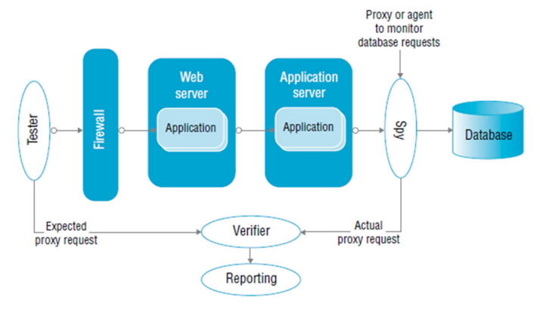
Basic Countermeasures …
Testing methodologies used to find the application vulnerabilities
Black box or system testing
White box or source testing
Grey box testing

Slide 18
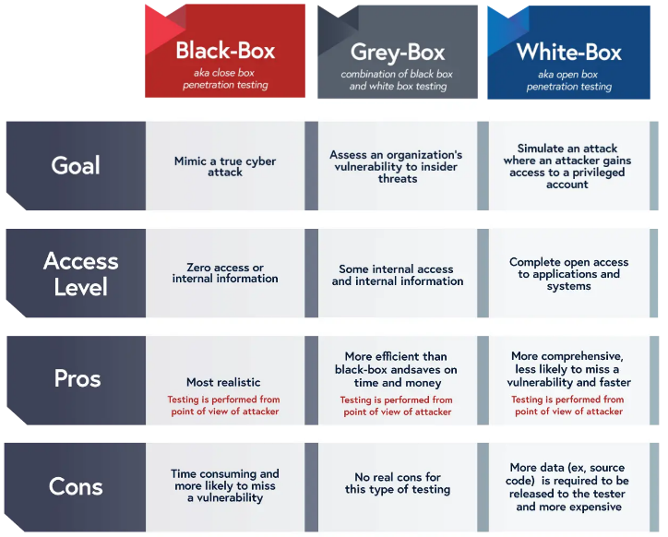
Black-Box vs Grey-Box vs White-Box

Slide 19
Basic Countermeasures …
Strategic countermeasures for protecting Web applications and to increase security awareness
Training
Communication of best practices across all business lines
Monitoring the security status
Categorizing application risk and liability
Set a zero-tolerance enforcement policy
Integrate security testing throughout the development and delivery process

Slide 20
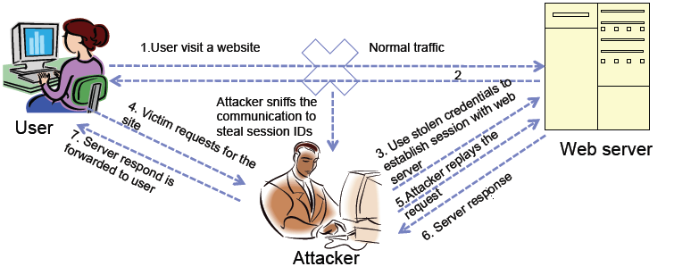
Cookie Replay Attack

Slide 21
ARP: Process

Slide 22
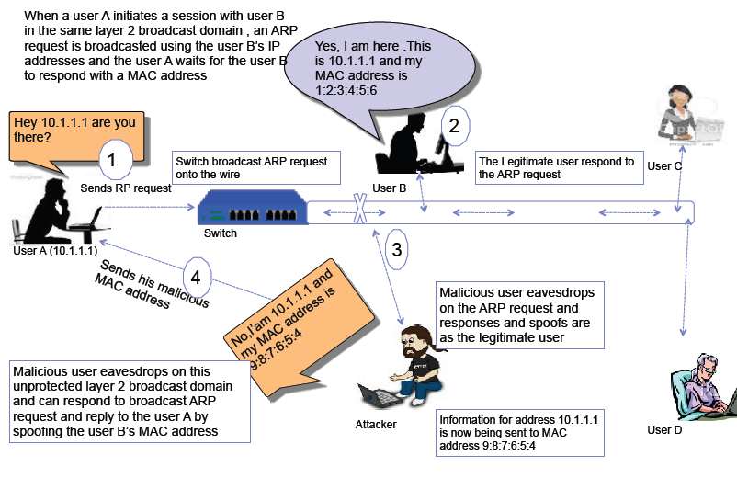
ARP Spoofing

Slide 23
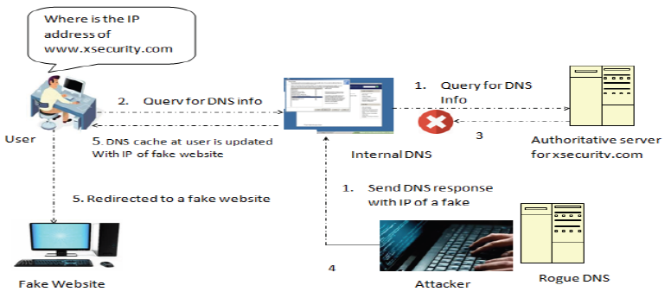
DNS Cache Poisoning
Man-in-the-middle attack: Real-life example and video walkthrough

Slide 24
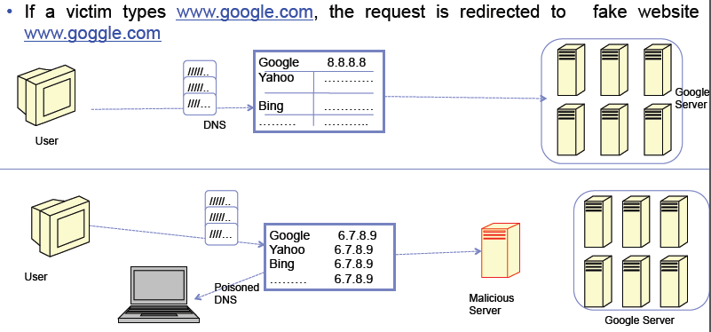
DNS Spoofing

